Slide 3
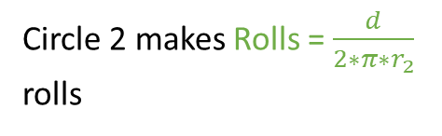
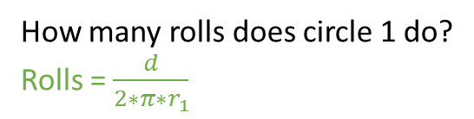
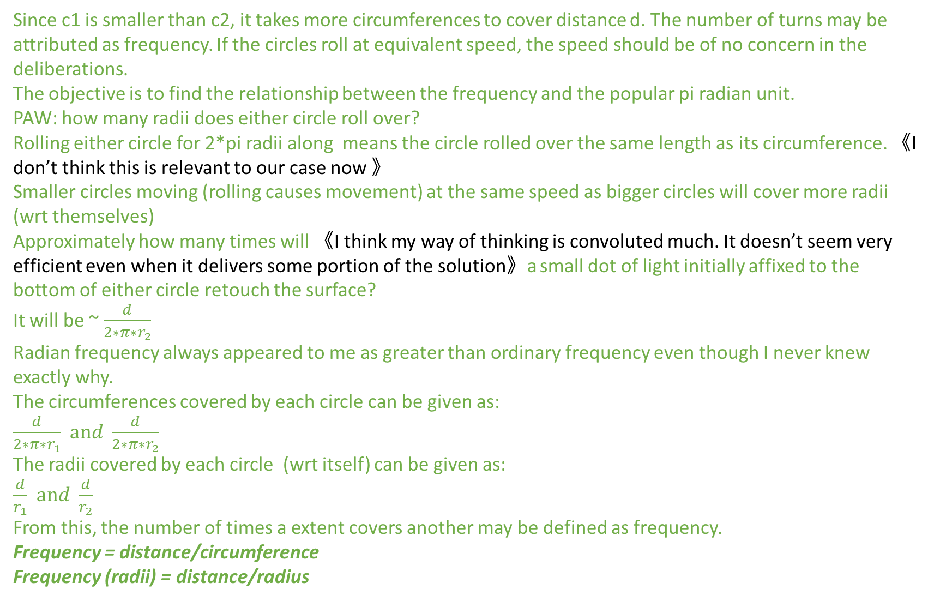
c1, circle 1 has radius r1
How many rolls does circle 1 do?
Rolls = $\frac{d}{2∗π∗r_{1}}$
c2, circle 2 has radius r2
Circle 2 makes Rolls = $\frac{d}{2∗π∗r_{2}}$
rolls
distance d
Since c1 is smaller than c2, it takes more circumferences to cover distance d. The number of turns may be attributed as frequency. If the circles roll at equivalent speed, the speed should be of no concern in the deliberations.
The objective is to find the relationship between the frequency and the popular pi radian unit.
PAW: how many radii does either circle roll over?
Rolling either circle for 2*pi radii along means the circle rolled over the same length as its circumference. 《I don’t think this is relevant to our case now 》
Smaller circles moving (rolling causes movement) at the same speed as bigger circles will cover more radii (wrt themselves)
Approximately how many times will 《I think my way of thinking is convoluted much. It doesn’t seem very efficient even when it delivers some portion of the solution》a small dot of light initially affixed to the bottom of either circle retouch the surface?
It will be ~ $\frac{d}{2∗π∗r_{2}}$
Radian frequency always appeared to me as greater than ordinary frequency even though I never knew exactly why.
The circumferences covered by each circle can be given as:
$\frac{d}{2∗π∗r_{1}}$ $and \frac{d}{2∗π∗r_{2}}$
The radii covered by each circle (wrt itself) can be given as:
$\frac{d}{r_{1}}$ $and \frac{d}{r_{2}}$
From this, the number of times a extent covers another may be defined as frequency.
Frequency = distance/circumference
Frequency (radii) = distance/radius

Slide 4
Drawing for the circle with equidistant points around its circumference and a corresponding graph of the heights of those self same points against their clockwise distance from the bottom of the circle.
There are manipulations (such as the translating of points on the circle to a graph of height against distance) whose meaning isn’t obvious. The diagram is something I learnt in 2014.
Observation: points are equally spaced on the circle, but the distributions of their heights aren’t equally spaced. Take for example [0, pi/4] and [pi/4,pi/2] and the interval of their heights. It seems obvious that heights from the first interval have greater dynamic range.

